Slide 1
Industrial Water Treatment
Sazab sanat pajouh co.
August 2019

Slide 2
Table of Contents
Industrial Solutions
Introduction
Physical Processes
Chemical Processes
Biological Processes
Sorption Processes
Membrane Processes
Sludge Treatment
Odor Management
Applications
Oil & gas & petrochemical Industry
Electroplating Industry
Food Industry
Paper Industry
Laboratories
Services

Slide 3
Industrial Solutions
Introduction
Chemical Processes
Biological Processes
Sorption Processes
Sludge Treatment
Physical Processes
Membrane Processes
Odor Management
Introduction
The major aim of wastewater treatment is to remove as much of the suspended solids as possible before the remaining water, called effluent, is discharged back to the environment. As solid material decays, it uses up oxygen, which is needed by the plants and animals living in the water. If wastewater is not properly treated, then the environment and human health can be negatively impacted.
Decaying organic matter and debris can use up the dissolved oxygen in a lake so fish and other aquatic biota cannot survive; Excessive nutrients, such as phosphorus and nitrogen (including ammonia), can cause eutrophication, or over-fertilization of receiving waters, which can be toxic to aquatic organisms, promote excessive plant growth, reduce available oxygen, harm spawning grounds, alter habitat and lead to a decline in certain species.
Our primary objective, is to help keep a cleaner and safer environment in this company.

Slide 4
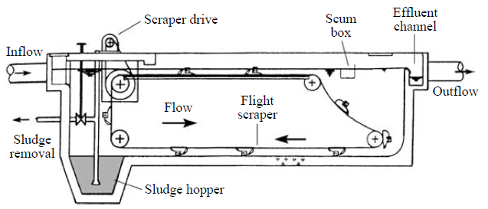
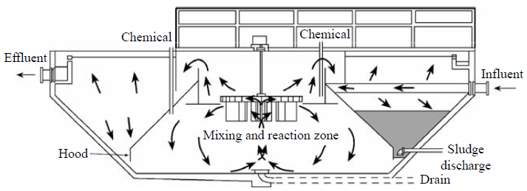
Industrial Solutions
Introduction
Chemical Processes
Biological Processes
Sorption Processes
Sludge Treatment
Physical Processes
Membrane Processes
Odor Management
Physical Processes
Many of the impurities in water and wastewater are in the form of suspended particles. Gross solids to be removed from aqueous streams can be categorized as follows:
Large floating and suspended solids objects e.g. pieces of wood, vegetable debris, fish, animal carcasses, plants, plastic debris, paper and rags
Silt and grit, typically particles of 10-100 mm diameter with density 2000-2600 kg/m3
Flocs and biomass, typically 100-1000 mm diameter with density 1005 – 1010 kg/m3
In order to provide effective removal of these different size particles during water and wastewater treatment, a range of physical processes can be employed such as screening, grit removal, sedimentation, floatation and filtration.
Horizontal Settling Tank
Solid Recirculation Clarifier

Slide 5
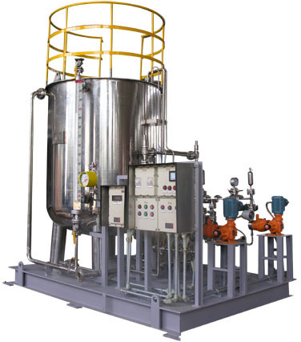
Industrial Solutions
Introduction
Chemical Processes
Biological Processes
Sorption Processes
Sludge Treatment
Physical Processes
Membrane Processes
Odor Management
Chemical Processes
By changing the chemistry of water and wastewater, the altered properties of the water can be used to provide the basis for operation of different water and wastewater unit processes.
The dosing of specific chemicals is used in order to enhance precipitation during sedimentation and different chemicals are involved in the disinfection of water and wastewater in order to control the number of bacteria and viruses prior to discharge to the environment or distribution. Chemicals are also used to inhibit the formation of specific compounds and improve the dewatering of sludge.
Chemical Dosing System

Slide 6
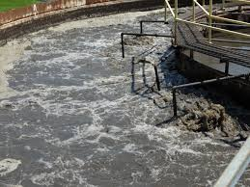
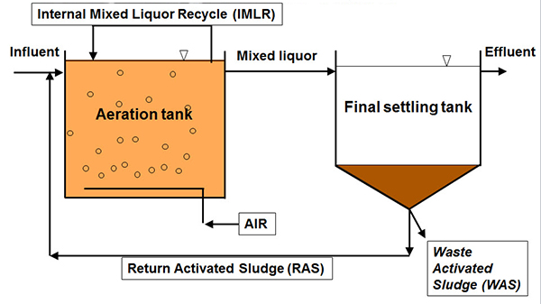
Industrial Solutions
Introduction
Chemical Processes
Biological Processes
Sorption Processes
Sludge Treatment
Physical Processes
Membrane Processes
Odor Management
Biological Processes
Biological Treatment of wastewater rely upon micro-organisms that utilize the dissolved and colloid organic matter as food. They can offer an economic alternative to other secondary chemical treatment processes.
Biological processes are usually applied after primary treatment as the wastewater still contains significant amounts of organic matter that needs to be removed before discharge.
Aerating Activated Sludge
Aerating Activated Sludge Process

Slide 7
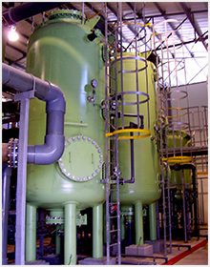
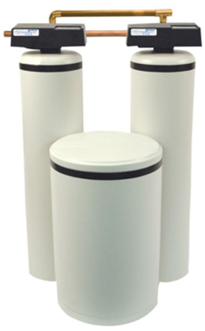
Industrial Solutions
Introduction
Chemical Processes
Biological Processes
Sorption Processes
Sludge Treatment
Physical Processes
Membrane Processes
Odor Management
Sorption Processes
In both water and wastewater treatment a wide range of organic material are amenable to removal by sorption. In water treatment, taste and odor compounds, pesticides and other disinfection by-products from chlorination can be removed by simple attachment to the surface of a solid substrate. In wastewater treatment, the intermediate addition of sorbent materials is used to improve sludge settleablitiy and remove toxic compounds.
Mixed – Bed Polisher
Water softener
Water Softener

Slide 8
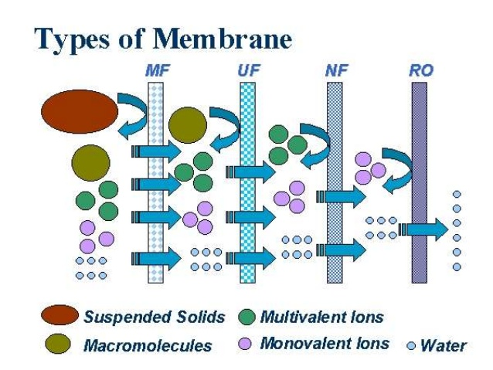
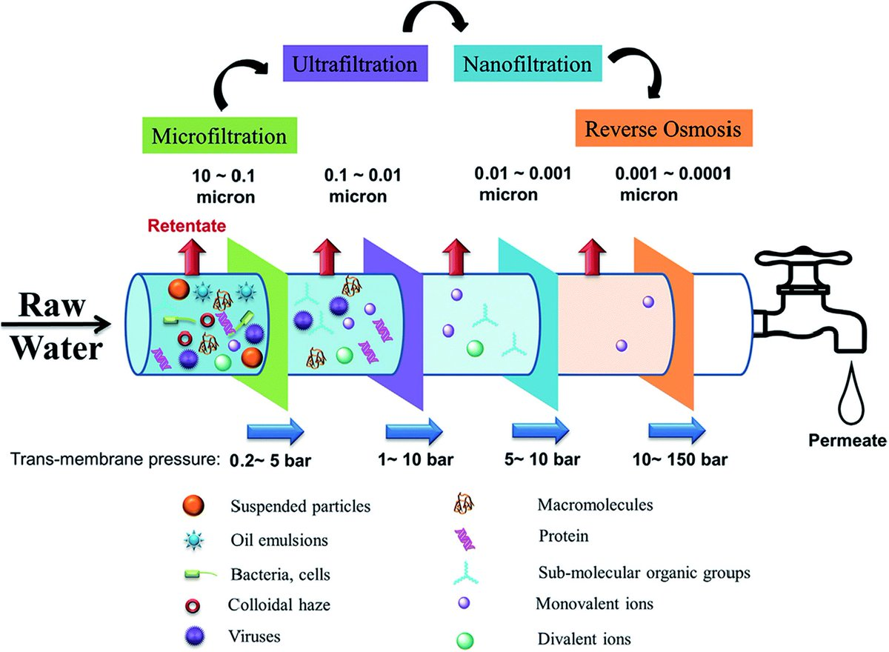
Industrial Solutions
Introduction
Chemical Processes
Biological Processes
Sorption Processes
Sludge Treatment
Physical Processes
Membrane Processes
Odor Management
Membrane processes
Membrane processes were first used in water treatment in the 1960s and are now an established technology. Although essentially a typical separation process, the range of membrane types and applications is such that membrane separation is generally regarded as a separate technology.
Types of Membranes
Different levels of filtration

Slide 9
Industrial Solutions
Introduction
Chemical Processes
Biological Processes
Sorption Processes
Sludge Treatment
Physical Processes
Membrane Processes
Odor Management
Sludge Treatment
An end product of water and waste water treatment processes is typically sludge; the mechanism of treating sludge depends heavily on the nature of the sludge to be treated. The presence of gross organic solids in sludge, pathogenic bacteria and toxic compounds all contaminate the sludge and so restrict the disposal options.

Slide 10
Industrial Solutions
Introduction
Chemical Processes
Biological Processes
Sorption Processes
Sludge Treatment
Physical Processes
Membrane Processes
Odor Management
Odor management
Water treatment has always produced unpleasant odors. However, the recent increase in the number of complaints about the release of odors from sewage and sludge treatment has forced water utilities to re-think the strategies for odor prevention and control. These growing environmental concerns about odor pollution have also led governments to consider odor policies that try to regulate odor emissions from wastewater treatment works.
The control of odor has become an important consideration in the design and the gaining of planning consent for new treatment works and solving sometimes long standing odors problems at existing works.

Slide 11
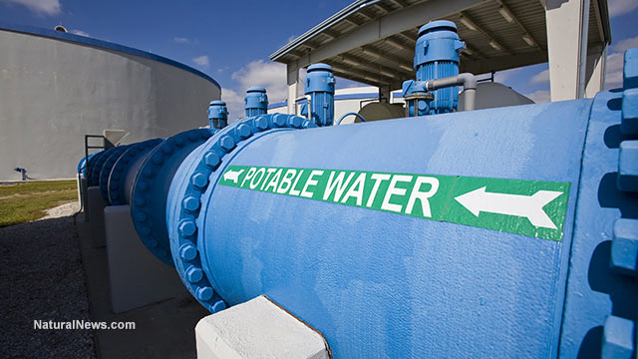
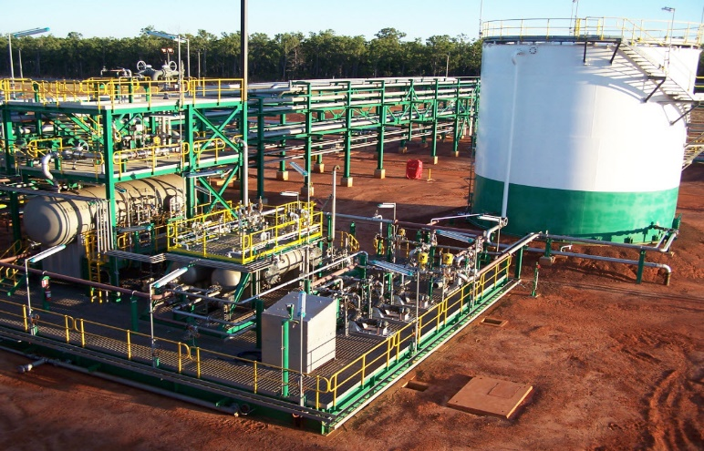
Applications
OG&P
Food Industry
Paper Industry
Electroplating Industry
Laboratories
Oil & gas & petrochemical Industry
Produced water is the largest waste stream generated in oil and gas industries. It is a mixture of different organic and inorganic compounds. Due to the increasing volume of waste all over the world in the current decade, the outcome and effect of discharging produced water on the environment has lately become a significant issue of environmental concern.
Produced water is conventionally treated through different physical, chemical, and biological methods. In offshore platforms because of space constraints, compact physical and chemical systems are used. However, current technologies cannot remove small-suspended oil particles and dissolved elements. Besides, many chemical treatments, whose initial and/or running cost are high and produce hazardous sludge.

Slide 12
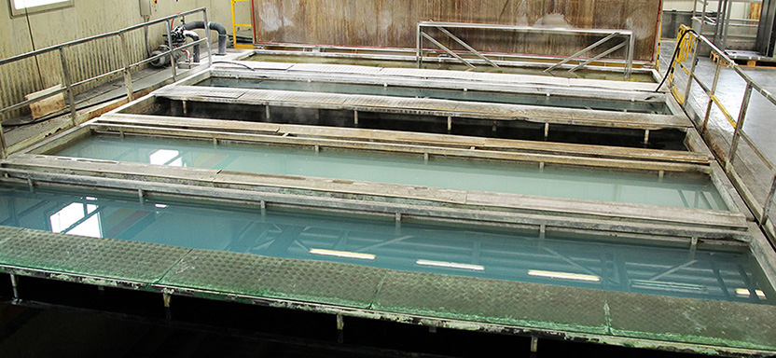
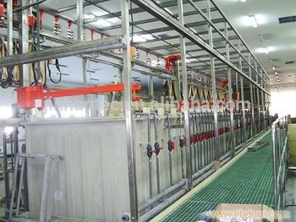
Applications
OG&P
Food Industry
Paper Industry
Electroplating Industry
Laboratories
Electroplating industry
Electroplating wastewater contains highly toxic cyanide, cyanide complexes and metal ions that makes treatment a complex problem. As the electroplating industries are located in tiny and unorganized sectors in India the problem becomes more grave.
Due to lack of technology, Automation and process control, there is considerable change in the effluent coming from these industries. Therefore the effluent exerts variable characteristics. It is observed that effluent has high BOD/ COD, SS, DS, TS, Color, and Turbidity and there is depletion of oxygen. Proper treatment has to be provided for the safe discharge of electroplating effluent.
Electroplating Lines

Slide 13
Applications
OG&P
Food Industry
Paper Industry
Electroplating Industry
Laboratories
Food industry
Food wastewater contains residues that deplete the oxygen in receiving streams. Chemical oxygen demand (COD) and biochemical oxygen demand (BOD5) are common measurements used to determine water quality. They measure the strength of the waste stream by measuring the oxygen required to stabilize the wastes. COD and BOD5 are important to the food processing industry because they can be used to indicate lost product and wasteful practices. High BOD5 and COD levels indicate increased amounts of product lost to the waste stream. Measurements at various process locations can help locate sources of waste.
At any point in a particular food processing operation, the relationship between BOD5 and COD is fairly consistent. However, the ratios of these two measures vary widely depending on the type of product.

Slide 14
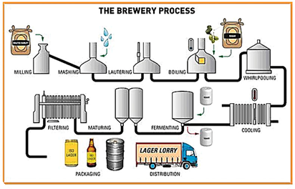
Applications
OG&P
Food Industry
Paper Industry
Electroplating Industry
Laboratories
Paper industry
Pulp and paper has a huge impact on our lives as we can't live without papers and it's other products in homes, offices, schools and everywhere. This paper will be about paper and pulp industry, it's contaminates, working of this industry, wastewater of this industry, its components its effect on the environment and how to treat it.
Pulp can be defined as the fibrous material obtained after the digestion of lignocelluloses and lignin that occur between the wood fibers and the hemicelluloses wood, straw or other annual plants consist of many different cell types that contain cellulose, hemicelluloses, and lignin and they are the main chemical components.
Brewery Process

Slide 15
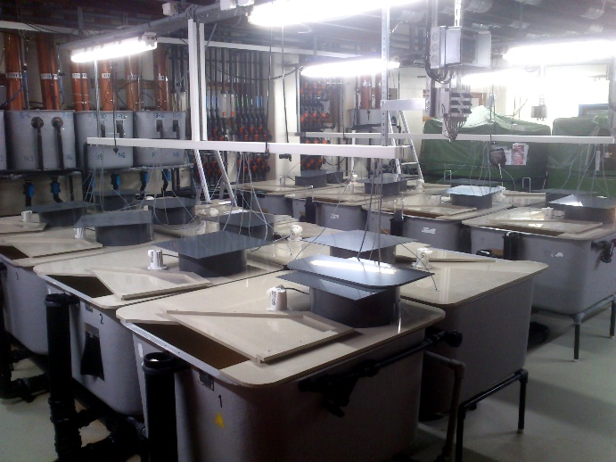
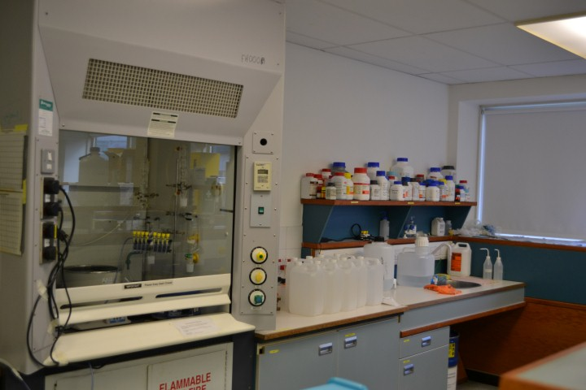
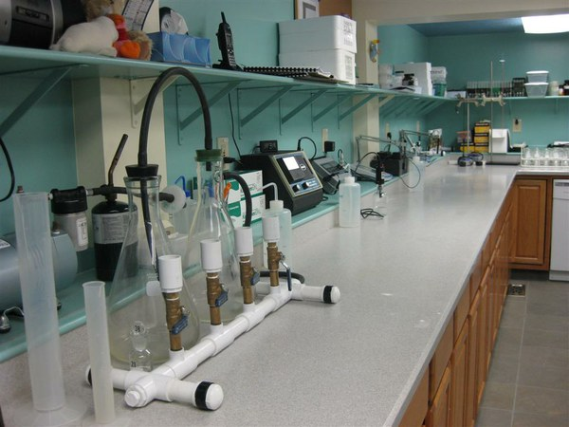
Applications
OG&P
Food Industry
Paper Industry
Electroplating Industry
Laboratories
Laboratories
Laboratory wastewater treatment heavily depends on the type of the laboratory. Depending on purpose of lab, whether educational or experimental or the field of lab, whether biological, chemical or etc. the treatment differs dramatically.
It is our job to identify and solve the needs of your industry and propose an efficient wastewater treatment for your lab.

Slide 16
Services
WE ARE HERE TO HELP!
Our company offers a lot. We can identify your needs and accordingly act as your consultant and engineering muscle.
Our deep experience in construction of civil works and water and wastewater pipelines and pumping stations and also hydro-mechanical works enables us to have a good provision upon the task.
A strong commercial and trading department helps us cooperate very well with our foreign partners to deliver a higher quality project.

